Slide 1
REPLICATION

Slide 2
INTRODUCTION
Maintenance of copies of data at multiple computers.
Replication provides enhanced performance, high availability and fault tolerance.
For example, the caching of resources from web servers in browsers and web proxy servers is a form of replication, since the data held in caches and at servers are replicas of one another.
The motivations for replication include:
Increased availability
Fault tolerance
Load balancing

Slide 3
Increased availability of service: When servers fail or when the network is partitioned.
– P: probability that one server fails= 1 – P= availability of service. e.g. P = 5% => service is available 95% of the time.
– P^{n}: probability that n servers fail= 1 – Pn= availability of service. e.g. P = 5%, n = 3 => service available 99.875% of the time
Fault tolerance:
– Under the fail-stop model, if up to f of f+1 servers crash, at least
one is alive.
Load balancing:
–One approach: Multiple server IPs can be assigned to the same name in DNS, which returns answers round-robin.

Slide 4
System model and the role of group communication
General system model for managing replicas:
The model involves replicas held by distinct replica managers, which are components that contain the replicas on a given computer and perform operations upon them directly.
This general model may be applied in a client-server environment, in which case a replica manager is a server.
Operations applied by a replica manager must be recoverable.
This means that if an operation fails partway through execution, it should not leave inconsistent results.
Recoverability is crucial for maintaining consistency and reliability in distributed systems.

Slide 5
General system model for managing replicas……….continues
Replica managers are sometimes required to function as state machines.
Replica manager applies operations to its replicas atomically, meaning that its execution is equivalent to performing operations in a strict sequence.
The state of replicas is determined solely by their initial states and the sequence of operations applied to them. This ensures deterministic behavior and facilitates consistency guarantees across replica managers.
Replicas of different objects may be maintained by different sets of replica managers
For example, one object may be needed mostly by clients on one network and another by clients on another network. There is little to be gained by replicating them at managers on the other network.

Slide 6
General system model for managing replicas……….continues
A collection of replica managers provides a service to clients.
The clients see a service that gives them access to objects, which in fact are replicated at the managers.
Each client requests a series of operations – invocations upon one or more of the objects. An operation may involve a combination of reads of objects and updates to objects.
Requested operations that involve no updates are called readonly requests; requested operations that update an object are called update requests.
Each client’s requests are first handled by a component called a front end. The role of the front end is to communicate by message passing with one or more of the replica managers, rather than forcing the client to do this itself explicitly.

Slide 7
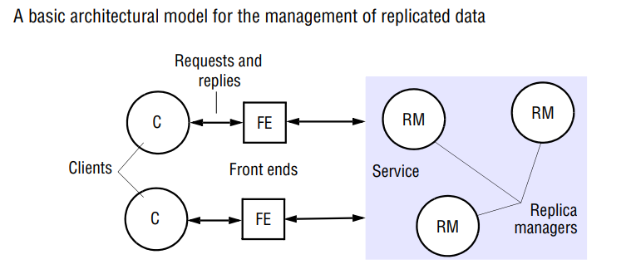
Five phases are involved in the performance of a single request upon the replicated objects:
Request: The front end issues the request to one or more replica managers
Coordination: The replica managers coordinate in preparation for executing the request consistently.
the order of requests
»FIFO ordering: If a FE issues r then r', then any correct RM handles r and then r’.
» Causal ordering: If the issue of r "happened before" the issue of r', then any correct RM handles r and then r’.
» Total ordering: If a correct RM handles r and then r', then any correct RM handles r and then r'.

Slide 8
Execution: The replica managers execute the request – perhaps tentatively: that is, in such a way that they can undo its effects later.
Agreement: The RMs attempt to reach consensus on the effect of the request.
– E.g., two phase commit through a coordinator
– If this succeeds, effect of request is made permanent
Response:
– One or more RMs respond to the front end.
– The first response to arrive is good enough because all the RMs will return the same answer.
• Each RM is a replicated state machine
– "Multiple copies of the same State Machine begun in the Start state, and receiving the same Inputs in the same order will arrive at the same State having generated the same Outputs."
• Does this remind you of anything? What communication primitive do you want to use?
– Group communication (reliable, ordered multicast)

Slide 9
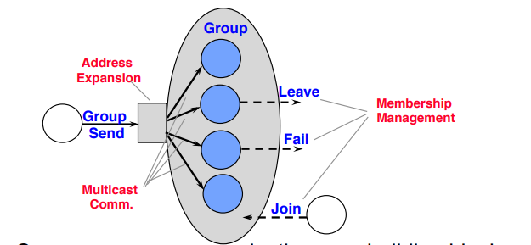
The Role of Group Communication
.
Can use group communication as a building block "Member"= process (e.g., an RM)
Static Groups: group membership is pre-defined
Dynamic Groups: members may join and leave, as necessary

Slide 10
Multicast with Dynamic Groups
How do we define something similar to reliable multicast in a dynamic
group?
Approach
Make sure all processes see the same versioned membership
Make sure reliable multicast happens within each version of the membership
Versioned membership: views
“What happens in the view, stays in the view.”

Slide 11
Views
A group membership service maintains group views, which are lists of current
group members.
This is NOT a list maintained by one member,
Each member maintains its own local view
A view V_{p}(g) is process p's understanding of its group (list of members)
Example: V_{p.0}(g) = {p}, V_{p.1}(g) = {p, q}, V _{p.2} (g) = {p, q, r}, V _{p.3} (g) ={p,r}
The second subscript indicates the "view number" received at p
A new group view is disseminated, throughout the group, whenever a member joins or
leaves.
Member detecting failure of another member reliable multicasts a "view change" message (requires causal-total ordering for multicasts)
The goal: the compositions of views and the order in which the views are received at different members is the same.

Slide 12
Views
An event is said to occur in a view v_{p,i}(g) if the event occurs at p, and at the time of event occurrence, p has delivered v_{p,i}(g) but has not yet delivered v_{p,i+1}(g).
Messages sent out in a view i need to be delivered in that view at all members in the
group
Requirements for view delivery
Order: If p delivers v_{i}(g) and then v_{i+1}(g), then no other process q delivers v_{i+1}(g)
before v_{i}(g).
Integrity: If p delivers v_{i}(g), then p is in all v_{i}(g).
Non-triviality: if process q joins a group and becomes reachable from process p, then eventually, q will always be present in the views that delivered at p.
» Exception: partitioning of group

Slide 13
View Synchronous Communication
View Synchronous Communication = Group Membership Service +
Reliable multicast
"What happens in the view, stays in the view"
It is virtual
View and message deliveries are allowed to occur at different physical times at different members

Slide 14
View Synchronous Communication Guarantees
Integrity: If p delivered message m, p will not deliver m again. Also p ∈ group (m), i.e.,
p is in the latest view.
Validity: Correct processes always deliver all messages. That is, if p delivers
message m in
view v(g), and some process q ∈ v(g) does not deliver m in view v(g), then the next
view v’(g) delivered at p will not include q.
Agreement: Correct processes deliver the same sequence of views, and the same
set of messages in any view.
– If p delivers m in V, and then delivers V', then all processes in V ∈ V' deliver m in
view V

Slide 15
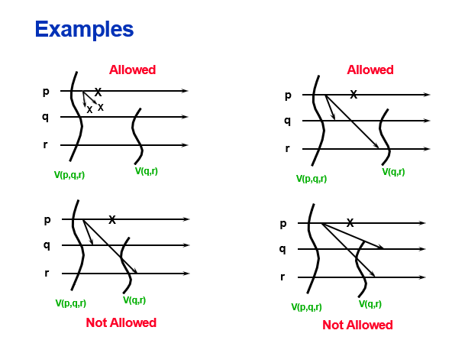
(a)
(b)
(c)
(d)
Consider a group with three processes, p, q and r. Suppose that p sends a message m while in view (p, q, r) but that p crashes soon after sending m, while q and r are correct. One possibility is that p crashes before m has reached any other process. In this case, q and r each deliver the new view (q, r), but neither ever delivers m (Fig. a). The other possibility is that m has reached at least one of the two surviving processes when p crashes. Then q and r both deliver first m and then the view (q, r) (Fig. b). It is not allowed for q and r to deliver first the view (q, r) and then m (Fig. c), since then they would deliver a message from a process that they have been informed has failed; nor can the two deliver the message and the new view in opposite orders (Fig. d).

Slide 16
State Transfer
(the usefulness of view-synchronous communication is how it can be used to achieve
state transfer)
When a new process joins the group, state transfer may be needed (at view delivery point) to bring it up to date
"state" may be list of all messages delivered so far (wasteful)
"state" could be list of current server object values (e.g., a bank database) – could be
large
Important to optimize this state transfer
View Synchrony = "Virtual Synchrony“
Provides an abstraction of a synchronous network that hides the asynchrony of the underlying network from distributed applications

Slide 17
The gossip architecture

Slide 18
The gossip architecture
The gossip architecture as a framework for implementing highly available services by replicating data close to the points where groups of clients need it.
The name reflects the fact that the replica managers exchange ‘gossip’ messages periodically in order to convey the updates they have each received from clients.

Slide 19
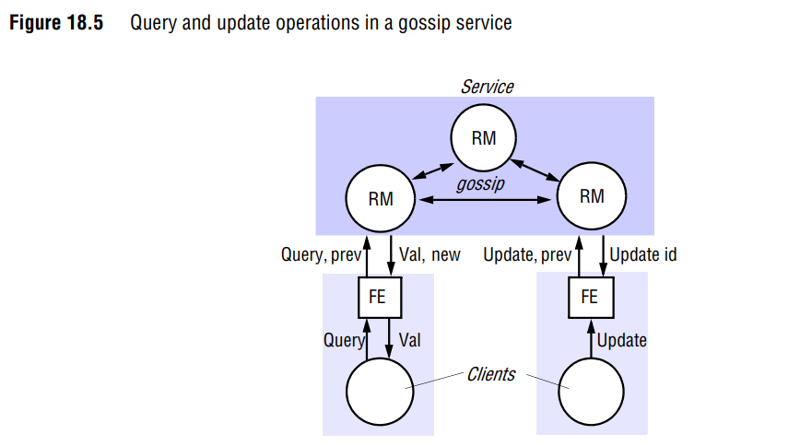
A gossip service provides two basic types of operation: queries are read-only operations and updates modify but do not read the state .

Slide 20
A key feature is that front ends send queries and updates to any replica manager they choose, provided it is available and can provide reasonable response times.
The system makes two guarantees, even though replica managers may be temporarily unable to communicate with one another:
Each client obtains a consistent service over time
Relaxed consistency between replicas:
The front end for a gossip service handles operations that the client makes using an application-specific API and turns them into gossip operations.

Slide 21
How a gossip service processes queries and update operations?
1. Request: The front end normally sends requests to only a single replica manager at a time.
2. Update response: If the request is an update, then the replica manager replies as soon as it has received the update.
3. Coordination: The replica manager that receives a request does not process it until it can apply the request according to the required ordering constraints. This may involve receiving updates from other replica managers, in gossip messages. No other coordination between replica managers is involved.
4. Execution: The replica manager executes the request.
5. Query response: If the request is a query, then the replica manager replies at this point
6. Agreement: The replica managers update one another by exchanging gossip messages, which contain the most recent updates they have received. They are said to update one another in a lazy fashion, in that gossip messages may be exchanged only occasionally, after several updates have been collected, or when a replica manager finds out that it is missing an update sent to one of its peers that it needs to process a request.

Slide 22
How replica managers process queries and updates?
The front end’s version timestamp :
• In order to control the ordering of operation processing, each front end keeps a vector timestamp that reflects the version of the latest data values accessed by the front end (and therefore accessed by the client).
This timestamp, denoted prev in Figure 18.5, contains an entry for every replica manager.
The front end sends it in every request message to a replica manager, together with a description of the query or update operation itself.
When a replica manager returns a value as a result of a query operation, it supplies a new vector timestamp (new in Figure 18.5), since the replicas may have been updated since the last operation. Similarly, an update operation returns a vector timestamp (Update ID in Figure 18.5) that is unique to the update.
Each returned timestamp is merged with the front end’s previous timestamp to record the version of the replicated data that has been observed by the client.

Slide 23
Replica manager state:
Regardless of the application, a replica manager contains the following main state components:
Value: This is the value of the application state as maintained by the replica manager. Each replica manager is a state machine, which begins with a specified initial value and is thereafter solely the result of applying update operations to that state.
Value timestamp: This is the vector timestamp that represents the updates that are reflected in the value. It contains one entry for every replica manager. It is updated whenever an update operation is applied to the value.
Update log: All update operations are recorded in this log as soon as they are received.

Slide 24
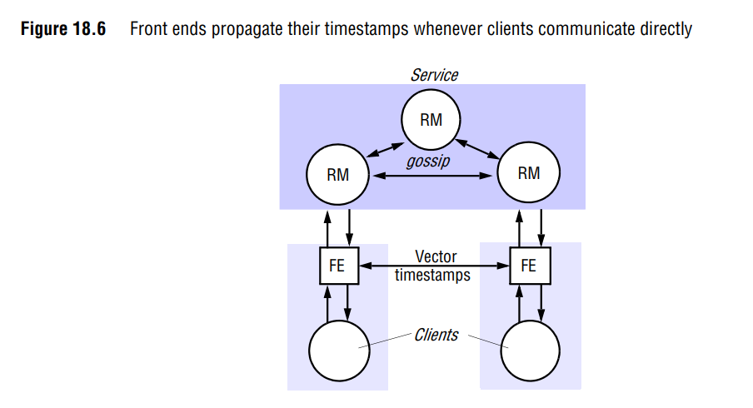

Slide 25
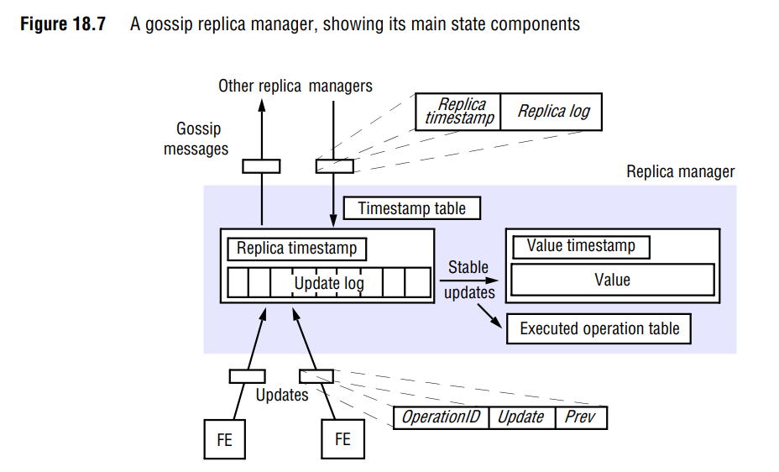

Slide 26
Replica timestamp: This vector timestamp represents those updates that have been accepted by the replica manager – that is, placed in the manager’s log.
Executed operation table: The same update may arrive at a given replica manager from a front end and in gossip messages from other replica managers. To prevent an update being applied twice, the ‘executed operation’ table is kept, containing the unique front-end-supplied identifiers of updates that have been applied to the value.
Timestamp table: This table contains a vector timestamp for each other replica manager, filled with timestamps that arrive from them in gossip messages. Replica managers use the table to establish when an update has been applied at all replica managers.

Slide 27
Problem scenario
The replica managers are numbered 0, 1, 2, .., : the ith element of a vector timestamp held by replica manager i corresponds to the number of updates received from front ends by i, and the jth component (j not equal i) equals the number of updates received by j and propagated to i in gossip messages. So, for example, in a three-manager gossip system a value timestamp of (2,4,5) at manager 0 would represent the fact that the value there reflects the first two updates accepted from front ends at manager 0, the first four at manager 1 and the first five at manager 2.

Slide 28
How the timestamps are used to enforce the ordering
Processing Query Operation:
A query q contains a description of the operation, and a timestamp q.prev sent by the front-end
• Q.prev reflects the latest version of the value that the front-end as read or submitted an
update to
The replica manager must return data at least as up to date as indicated by q.prev
• Q.prev <= Value Timestamp
The replica manager keeps q on the hold-back queue until this condition is satisfied
• It can await the missing updates or it can explicitly request updates from replica managers
Eventually (liveness), the replica manager’s value will satisfy the condition and the query can complete
Notes:
:

Slide 29
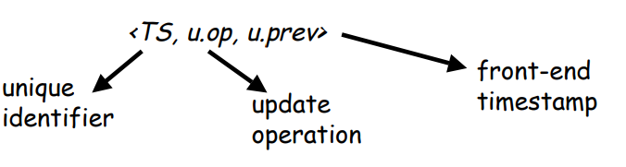
Processing Update Operations (causal)
On receiving an update request, the replica manager increments its own element in its Replica Timestamp.
This keeps count of the number of updates it has received directly from front-ends
The update is assigned a unique identifier and a record for the update is placed in the replica manager’s log
TS is derived from u.prev by replacing its i th element by that of the replica manager timestamp, assuming replica manager i received the update from the front-end
TS is passed back to the front-end immediately, and is merged with the front-ends timestamp

Slide 30
Processing Update Operations (causal)
The update u is stable when…
u.prev <= value timestamp
ie. Stable when all updates on which this update depends have already been applied
If u.prev > value timestamp, update is not performed
When new gossip messages arrive, and value timestamp changes, the test will be performed again
Eventually, the update will be performed
• Its call identifier will be added to the lst of executed calls
• The value timestamp will be updated to reflect this new update

Slide 31
Gossip Messages
Normally contain information concerning several updates…
Replica timestamp
Log of updates
Receiving replica manager has 4 tasks
Merge the arriving log with its own
Add each log entry (r) unless its already in the log, or if the log entries timestamp, r.ts <= value timestamp
Apply any updates that have become stable
This may lead to an avalance effect
Eliminate log entries and entries in the list of executed call identifiers when it is known that updates have been applied everywhere
Merge timestamp of incomming gossip message with replica managers own replica timestamp

Slide 32
Summary
Replicating objects across servers improves performance, fault-tolerance, availability
• Raises problem of Replica Management
• Group communication an important building block
• View Synchronous communication service provides totally
ordered delivery of views + multicasts
• RMs can be built over this service
Gossip Architecture

